Slide 1

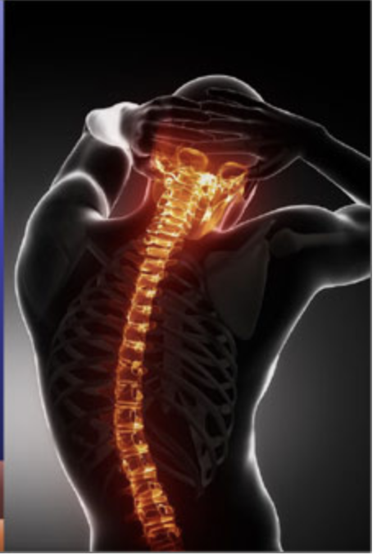
AI to explore the Brain Tumor dataset
-- Medical Image Analysis
Milestone 3
Yuyang Zhu yz3691
Tianle Zhu tz2434

Slide 2
Outline
Project Recap
Implementation and progress of the project
Challenges and solutions
Exploration and discussion
Reference

Slide 3
Project Recap
Object for Milestone Three：
Object detection -- YOLO (Brain MRI dataset)
Datasets:
The Brain Tumor Dataset:
155 brain MRI images with tumor
98 brain MRI images without tumor
The Brain MRI Segmentation dataset
4568 brain MRI images from 110 patients
The Brain MRI dataset:
Combine the Brain Tumor Dataset with the Brain MRI Segmentation dataset(our next step)

Slide 4
Project Recap
Pipeline:
Image Annotation[1]
Install Visual Object Tagging Tool (VoTT)
Annotate images
Training
Download pre-trained weights
Train custom YOLO model on annotated images
Brain Tumor Dataset
Brain MRI Segmentation dataset
Inference
Detect objects in new images (the testing dataset)
Brain Tumor Dataset
Brain MRI Segmentation dataset
Notes:
Yolo vs C

Slide 5
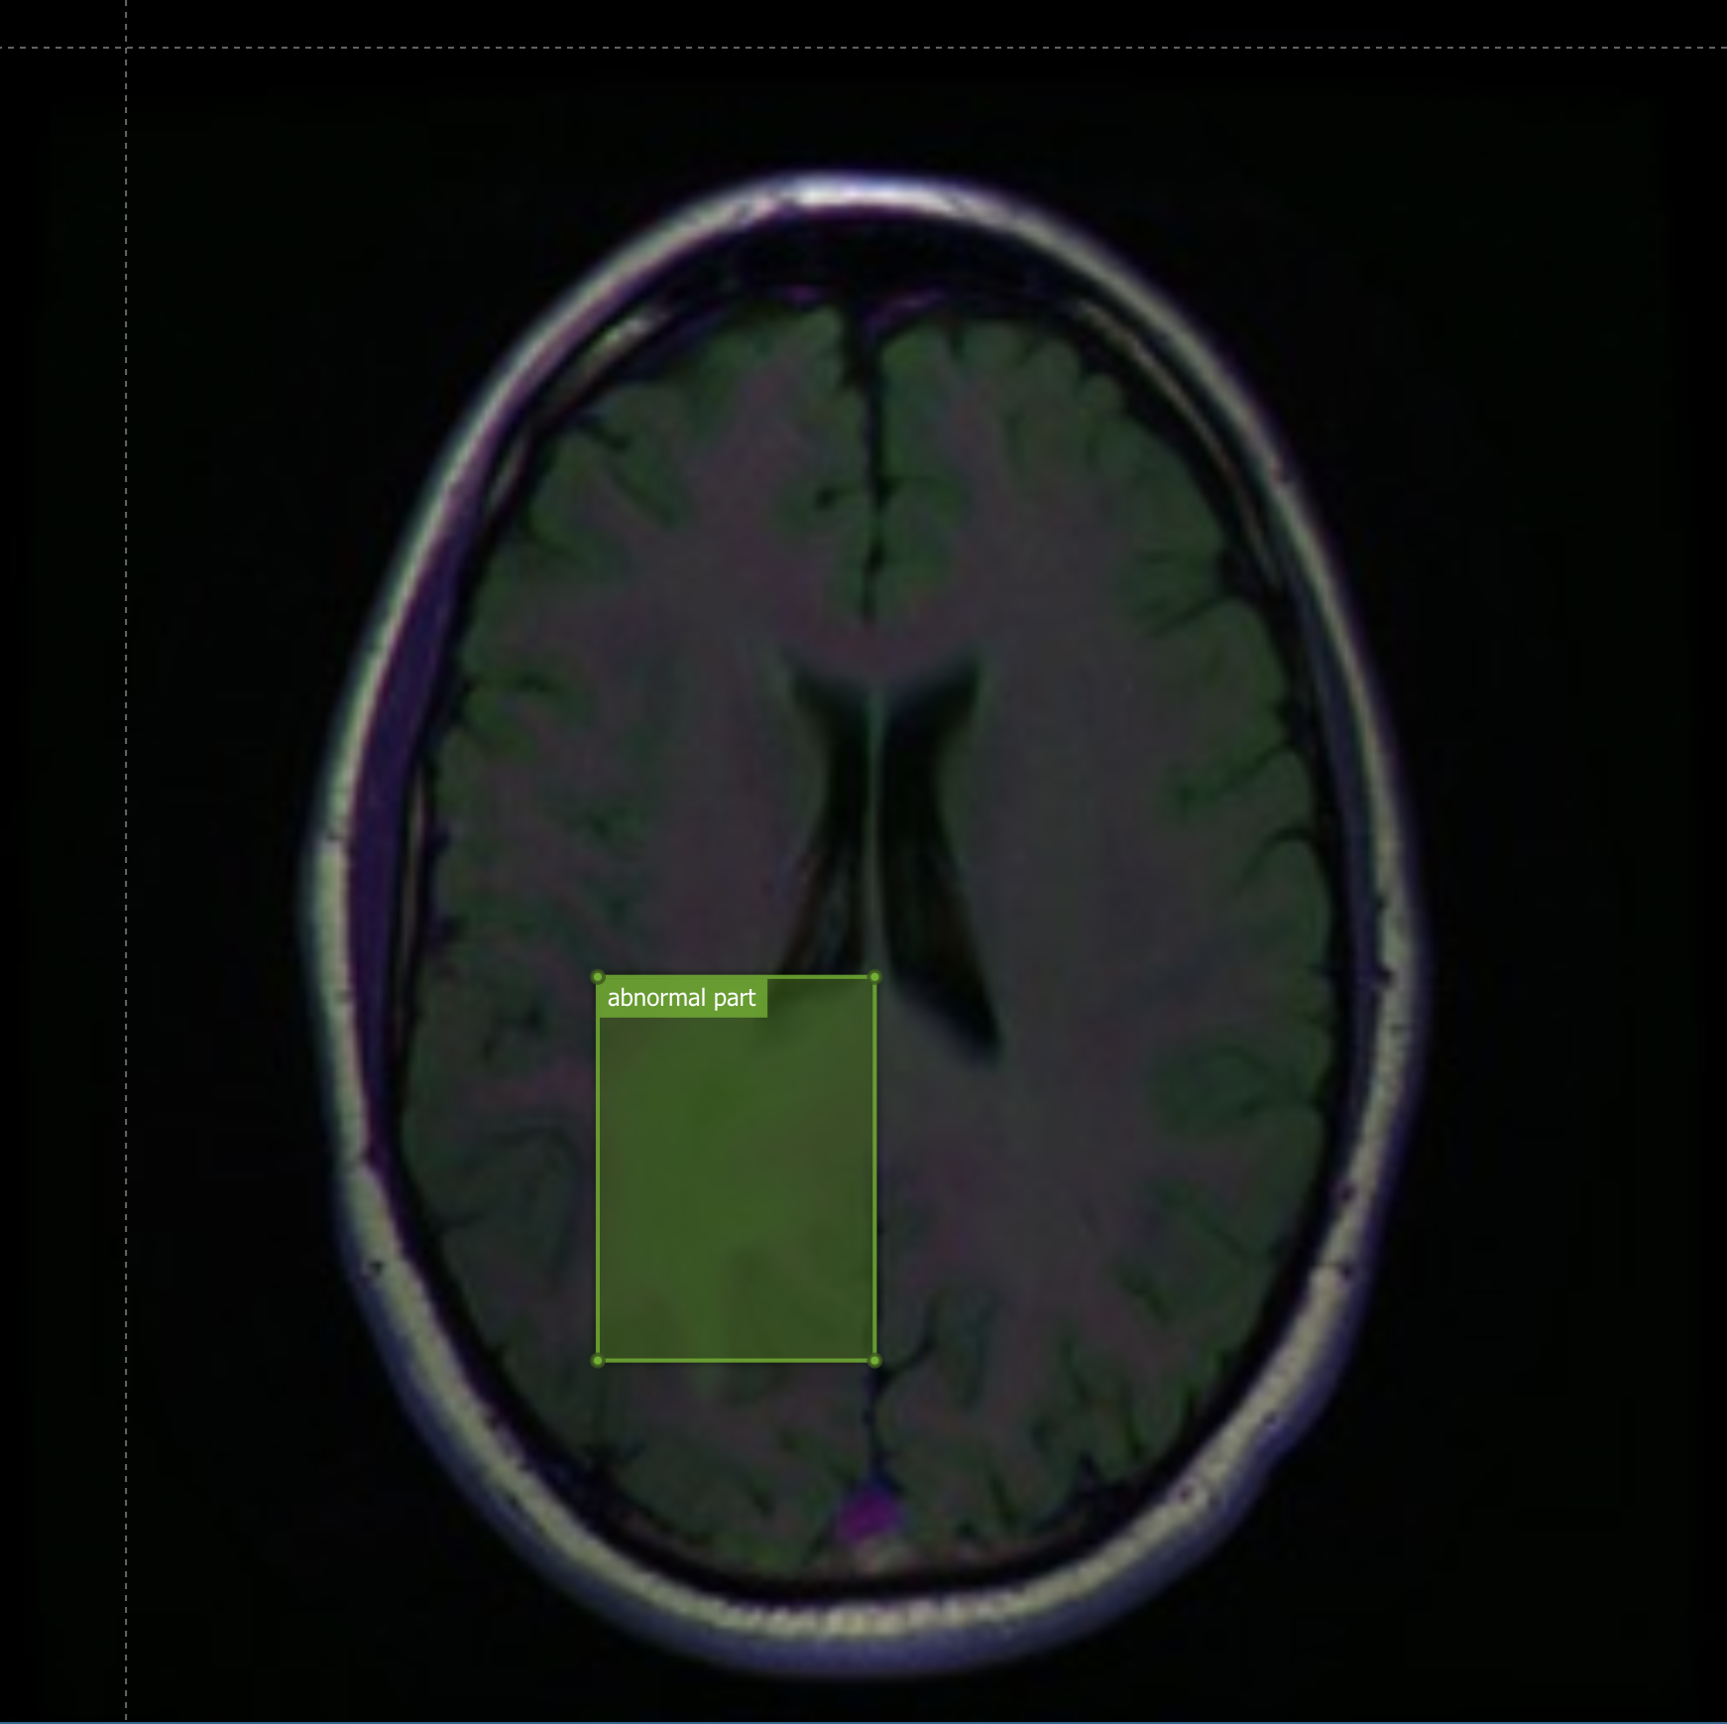
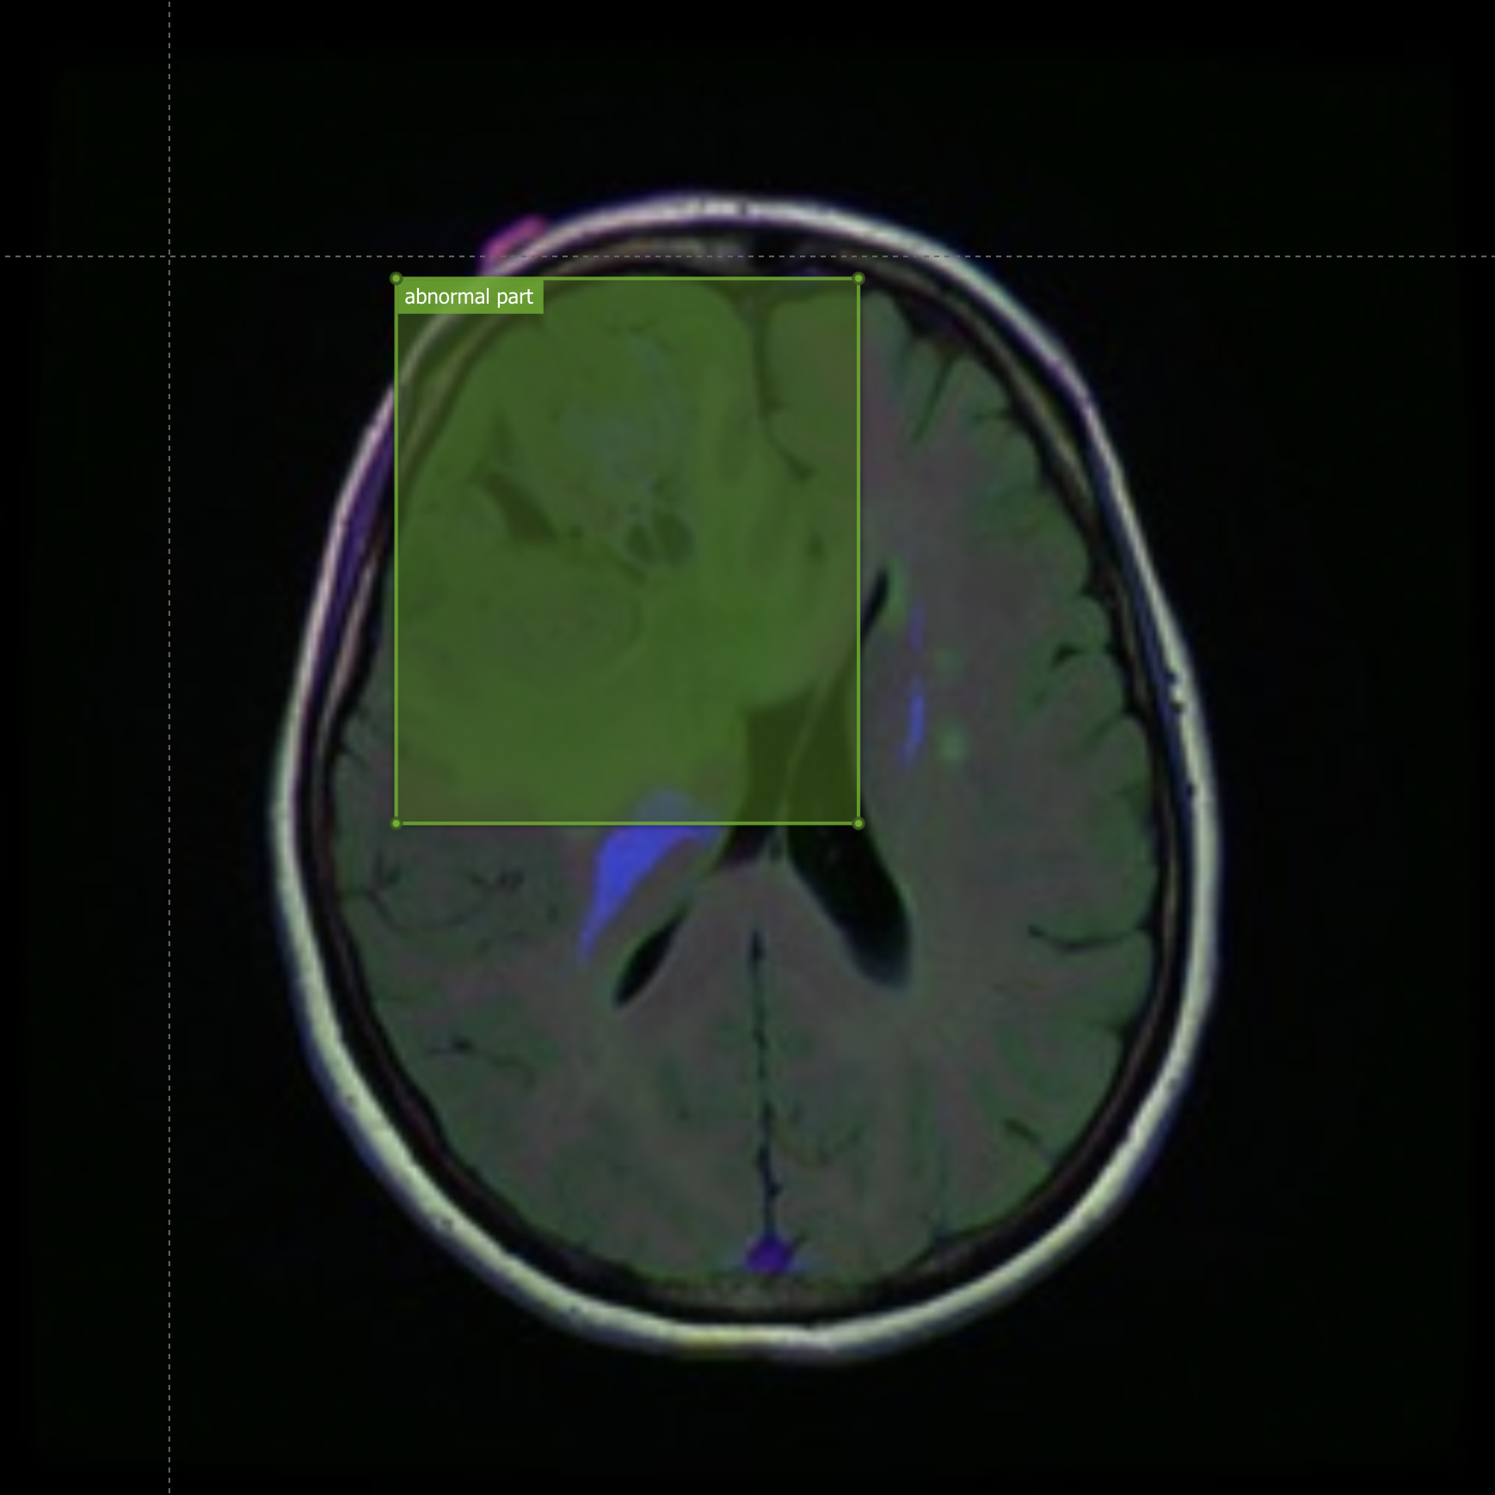
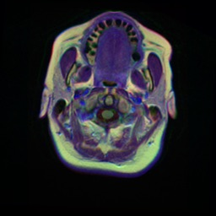
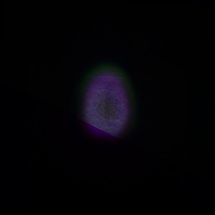
Implementation and Progress
Preprocessing:
Filter out some starting and ending images for each patient
Giving a rectangular label to every image
Sample Inputs Some invalid images in prediction

Slide 6
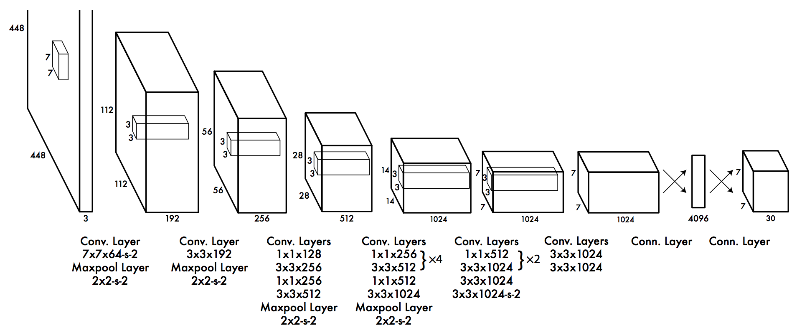
Implementation and Progress
Training the model:
First train it on the Brain Tumor MRI dataset, then train on the Brain MRI segmentation dataset.
Use weights downloaded from darknet
Visualization of fast YOLO

Slide 7
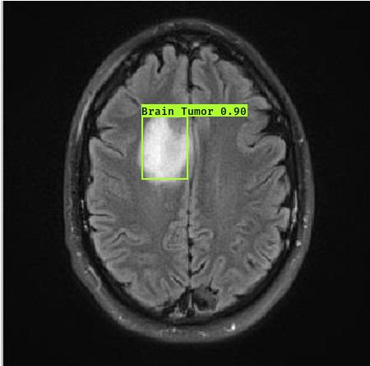
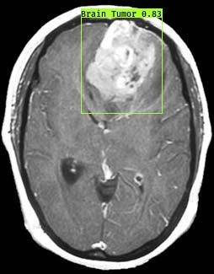
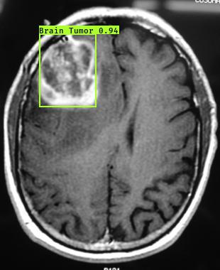
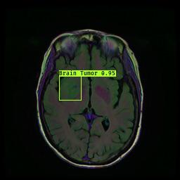
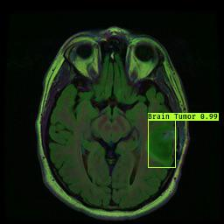
Implementation and Progress
Results:
Brain Tumor dataset: Brain MRI segmentation dataset:
The bounding box is the predicted label of the image, and the number on it shows the probability likelihood of the prediction(0-1)

Slide 8
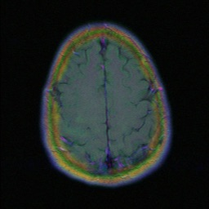
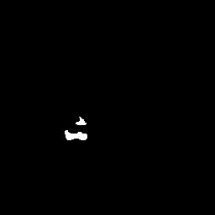
Challenges and Solution
Some labeling might be erroneous since we are manually labeling the images(and some masks are indistinguishable).
YOLO model struggles with small objects that appear in groups(such as tiny brain tumor features)
Some masks are highly indistinguishable in the original image, we cannot give a very accurate label unless we plot the outline of the mask in the image.

Slide 9
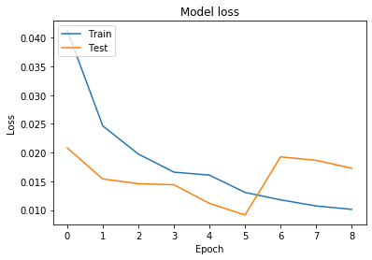
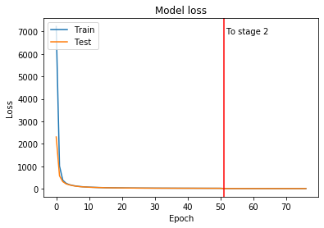
Challenges -- YOLO vs U-net:
Loss function plot:
U-net(using cross-entropy)
YOLO(using customized yolo loss),
Which is using a more flexible learning rate and batch size in training.

Slide 10
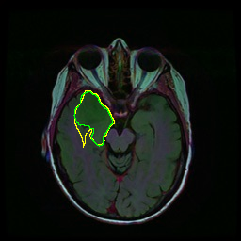
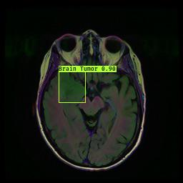
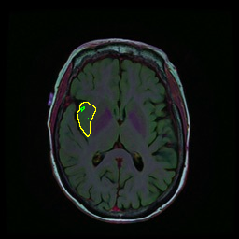
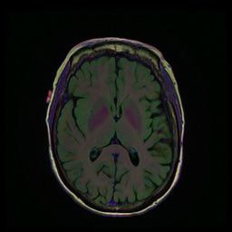
Challenges -- YOLO vs U-net:
Prediction accuracy for test images:
We are using manual encoding scores to calculate the accuracy of predicted images:
Accurate prediction(yellow line is the true mask,green line is predicted mask)
Inaccurate prediction
U-net accuracy: 91.125%
YOLO accuracy:90.625%
The result is quite similar, in most inaccurate predictions, they both make similar mistakes(especially when the mask itself is small or indistinguishable). But other than that U-net is most likely to make false negative predictions, while YOLO is more likely to make false positive predictions and rarely have false negatives(1 in 160)

Slide 11
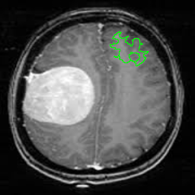
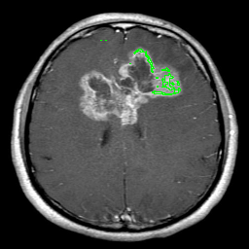
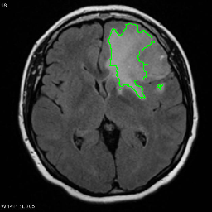
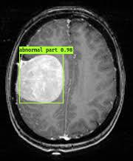
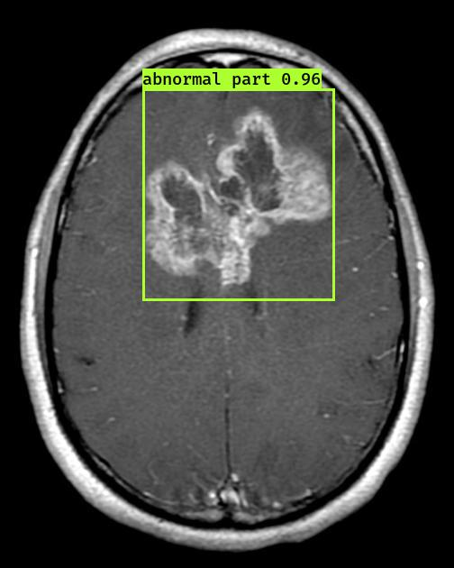
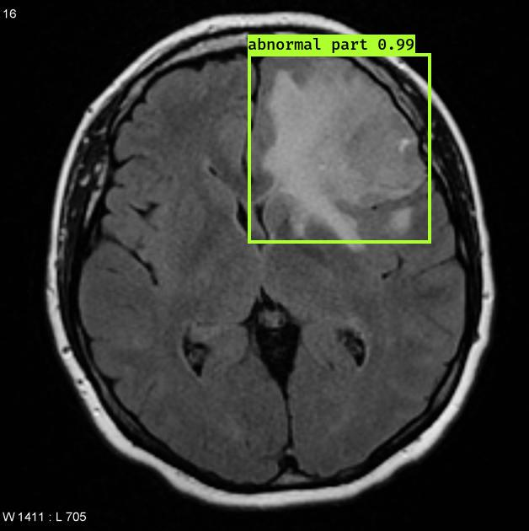
Challenges -- YOLO vs U-net:
Generalizing to other datasets:
We are only training the current model on Brain MRI segmentation dataset, but the Brain tumor dataset actually shares very similar features with the Brain MRI segmentation dataset, so whether the model can be generalized to a similar dataset could be a good measurement of the model goodness.
YOLO: YOLO is doing much better when we are generalizing the dataset. It stills has a small false positive rate, but it has a much higher true positive rate(about 84%) than U-net. Which shows that YOLO is a more generalized model and we can expect that YOLO would have better performance when we have other similar Brain MRI images.
Unet: Perform poorly on the similar dataset, it only predicts 20% percent of the abnormal parts and has about 30% of false positive rate, looks like it fails to find features like abnormal distensions in the image.

Slide 12
Exploration and Discussion
YOLO model struggles with small objects such as cannot detect minor brain tumor, we explored other detection systems to deal with this problem.
R-CNN
Similarities:
proposes potential bounding boxes
uses the convolutional feature to score those boxes.
Differences:
uses region proposals instead of sliding windows to find objects in images.
classifies each region using class-specific linear SVMs
non-max suppression eliminates duplicate detections

Slide 13
Reference
https://www.kaggle.com/mateuszbuda/lgg-mri-segmentation
https://www.kaggle.com/loaiabdalslam/brain-tumor-mri-classification-vgg16
K. He, X. Zhang, S. Ren, and J. Sun. Deep residual learning for image recognition.In Proceedings of the IEEE conference on computer vision and pattern recognition,pages 770–778, 2016.
K. Simonyan and A. Zisserman. Very deep convolutional networks for large-scale image recognition.arXiv preprint arXiv:1409.1556, 2014
https://github.com/AntonMu/TrainYourOwnYOLO/tree/master/1_Image_Annotation

Slide 14

Notes:
Milestone 1 will be evaluated based on these criteria:
1. Literature Survey / Past Related Work
2. Data Collection Difficulty
3. Novelty (e.g., Scientific / Business Value)
4. Technical Challenge
5. Milestone Planning
6. Presentation / Writing Clarity & Quality

